Slide 1

Skin Cancer Binary Classifier

Slide 2

Exploratory Data Analysis

Slide 3

Data Loading
• Load the dataset, including images and metadata.
• Ensure images are read and preprocessed correctly, with file paths accurately linked to labels.
• Verify the integration of all data sources for a comprehensive dataset.
• Conduct an initial check for data integrity issues, addressing missing files or incorrect labels.

Slide 4

Data Visualization
• Visualize a random sample of images to assess their quality and characteristics.
• Plot the distribution of malignant and benign cases to evaluate dataset balance.
• Optionally, visualize metadata such as patient age or lesion location for additional insights.

Slide 5
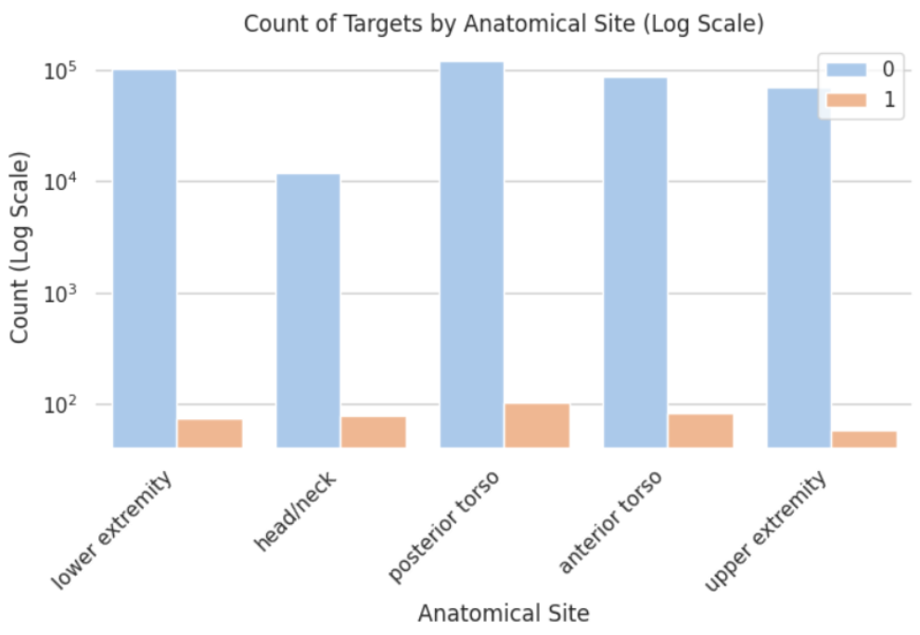

Slide 6
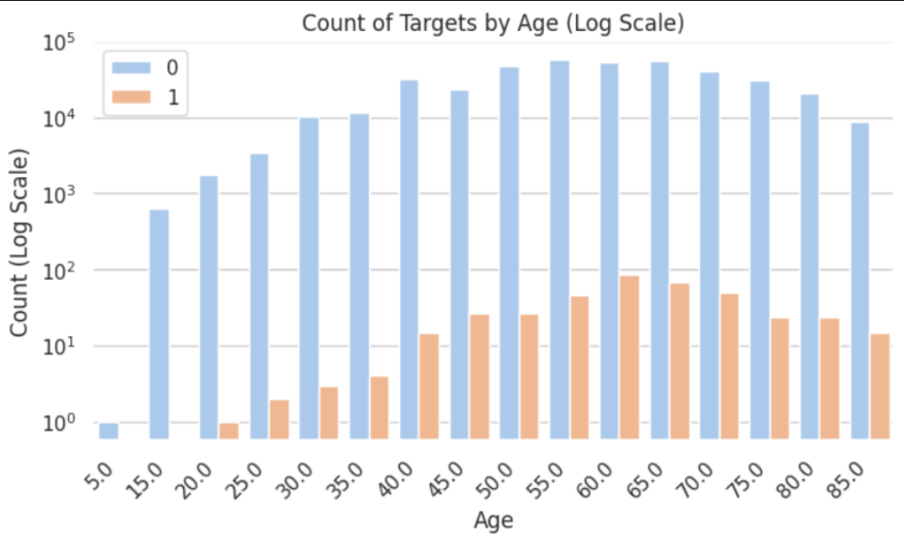

Slide 7
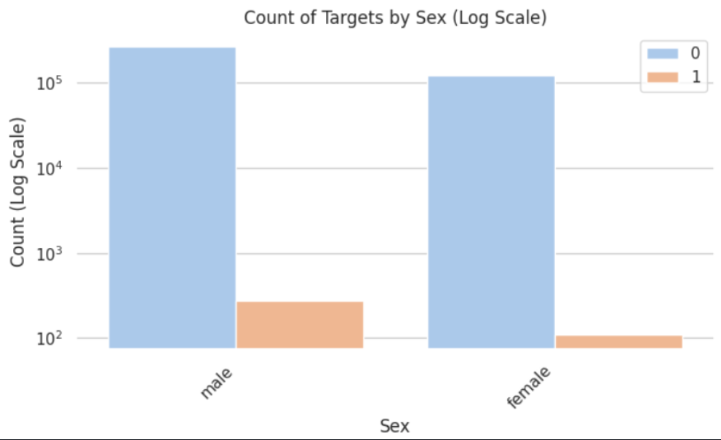

Slide 8

Statistical Analysis
• Calculate basic statistics for image dimensions, including mean and standard deviation.
• Analyze metadata for insights like patient age and lesion location.
• Explore correlations between metadata features and image labels.

Slide 9

Class Distribution
• Check for class imbalance between malignant and benign lesions.
• Visualize class distribution using bar charts or pie charts.
• Plan strategies to address any identified class imbalance.

Slide 10

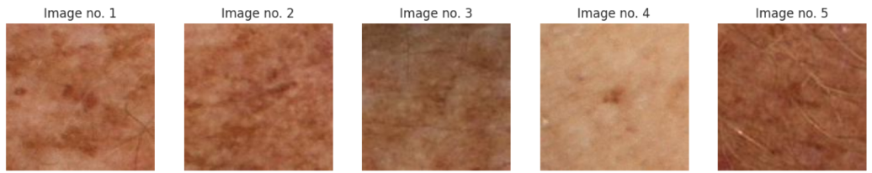
Preprocessing

Slide 11

Data Cleaning
Remove duplicates and errors.
Handle missing values appropriately.
Standardize data formats.
Data Augmentation
Apply random transformations (rotation, flip).
Adjust brightness, contrast, and saturation.
Generate synthetic data samples.

Slide 12

Image Normalization
Scale pixel values to a specific range.
Adjust for mean and variance.
Normalize across all images consistently.
Resizing and Cropping
Resize images to a fixed dimension.
Crop images to remove irrelevant areas.
Maintain aspect ratio during resizing.

Slide 13
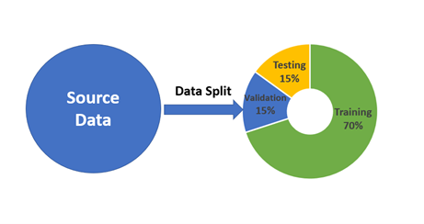
Data Splitting

Slide 14

Model Selection
• XGBoost: Robust for regression tasks, handles large datasets.
• AdaBoost: Boosts weak learners, effective for classification.
• LGBM Classifier: Fast gradient boosting, high accuracy.
• SVM: Effective for high-dimensional data, versatile kernels.
• Logistic Regression: Simple yet effective for binary classification.

Slide 15

Model training
Hyperparameter Tuning: Optimize parameters with grid search, random search, or Bayesian optimization.
Cross-Validation: Employ k-fold cross-validation for model robustness and generalizability.
XGBoost Training: Adjust learning rate, maximum depth, and number of estimators.
SVM Training: Tune regularization parameter (C) and kernel parameters.
Neural Network Training: Define architecture, activation functions, and optimizer.

Slide 16

Model Evaluation
Performance Metrics: Use accuracy, precision, recall, F1-score, and AUC for comprehensive evaluation.
Validation Set: Monitor validation set performance to avoid overfitting.
Confusion Matrix: Analyze error types and model performance through the confusion matrix.

Slide 17
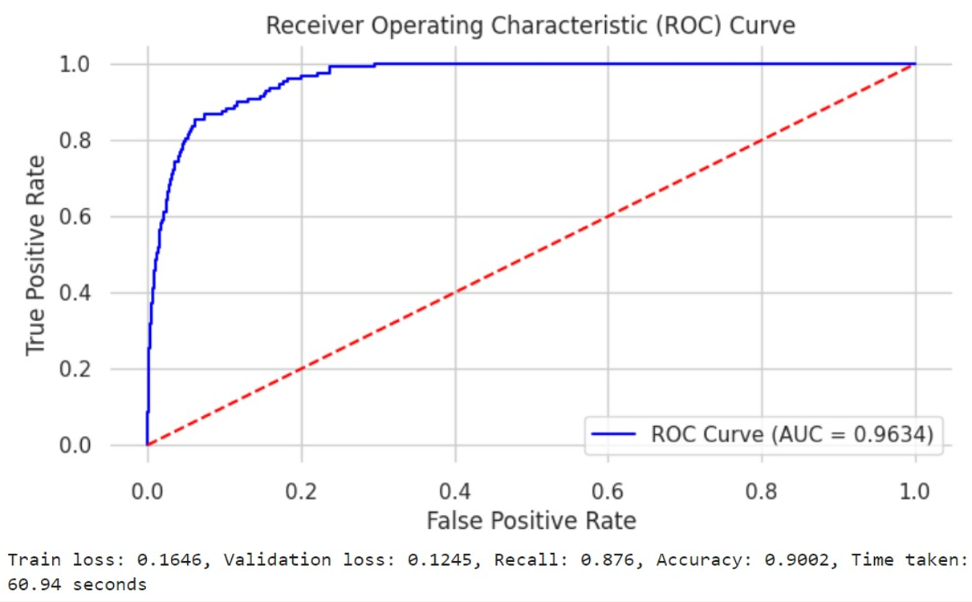
Results

Slide 18
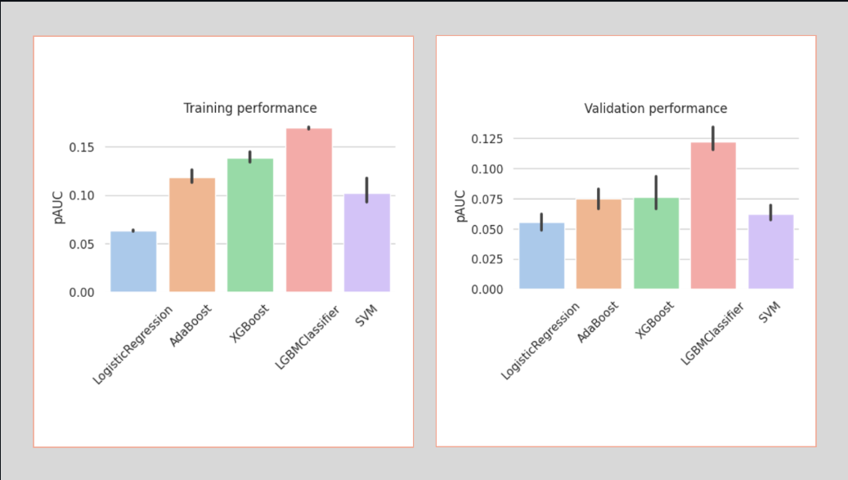

Slide 19

Thank You

